Slide 1
Continuous Action Games and Repeated Games
Frank-Edward Nemeth

Slide 2
Topic chosen
Evaluation, comparison and simulation of two types of learning algorithms
continuous action games: Best-response (BR) and gradient play (GP).
Motivations: learning connections, hyper parameter evaluation

Slide 3
Overview
Pre-requisite knowledge
Overview of relevant lecture material
Problem definition
Scope of this project
Methods
Results
Future Steps

Slide 4
Lecture Material
Continuous Games
Iterative Algorithms

Slide 5
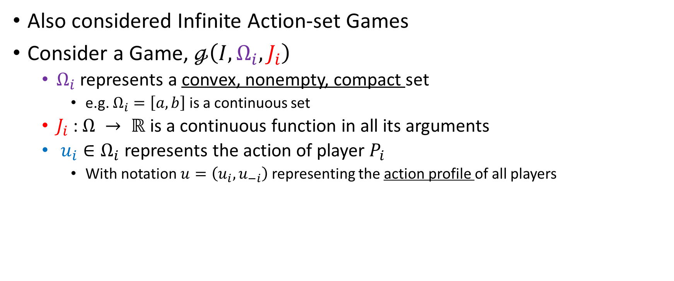
Continuous Kernel Games
Also considered Infinite Action-set Games
Consider a Game, $ℊ\left(I, Ω_{i},J_{i}\right)$
$Ω_{i}$ represents a convex, nonempty, compact set
e.g. $Ω_{i}=\left[a,b\right]$ is a continuous set
$J_{i}$ :$Ω → ℝ$ is a continuous function in all its arguments
$u_{i}∈Ω_{i}$ represents the action of player $P_{i}$
With notation $u=\left(u_{i}, u_{−i}\right)$ representing the action profile of all players

Slide 6

Existence of Nash Equilibrium
By definition,
$u^{∗}∈Ω$ is a NE if:
$$J_{i}\left(u_{i}^{∗}, u_{−i}^{∗}\right)≤J_{i}\left(u_{i}, u_{−i}^{∗}\right)$$
$$u_{i}^{∗}∈BR_{i}\left(u_{−i}^{∗}\right), ∀i∈I$$
$$u^{∗}∈BR\left(u^{∗}\right)$$
Where,
$$BR_{i}\left(u_{−i}\right)=\underset{u_{i}∈Ω}{argmin}{J_{i}\left(u_{i}, u_{−i}\right)}$$

Slide 7

(DFG) Debren-Fan-Glicksberg Theorem
Consider a Game, $ℊ\left(I, Ω_{i},J_{i}\right)$
$Ω_{i}$ represents a convex, nonempty, compact set
e.g. $Ω_{i}=\left[a,b\right]$ is a continuous set
$J_{i}$ is a continuous function in $u$ and is convex in $u_{i}$
Then $ℊ$ admits at least a Nash Equilibrium in “pure” strategies

Slide 8

Repeated Games
$ℊ\left(I, Ω_{i},J_{i}\right)$ is played at every kth iteration
The game is played repeatedly
Player $P_{i}$ uses the information of $P_{−i}$ to update his / her strategy

Slide 9

Iterative Algorithms (focus)
Best Response (BR) Play:
$$u_{i}^{k+1}=u_{i}^{k}+α\left[BR_{i}\left(u_{−i}^{k}\right)−u_{i}^{k}\right]$$
Gradient Play:
$$u_{i}^{k+1}=u_{i}−α ∇_{u_{i} }J_{i}(u_{i},u_{−i})$$

Slide 10
Objective
To explore these two iterative algorithms, BR-Play and Gradient Play, in order to identify their characteristics, and use cases in continuous games
Interested in breadth
Looking into how changing different parameters in each algorithm can affect the overall outcome of each, and to what extent

Slide 11
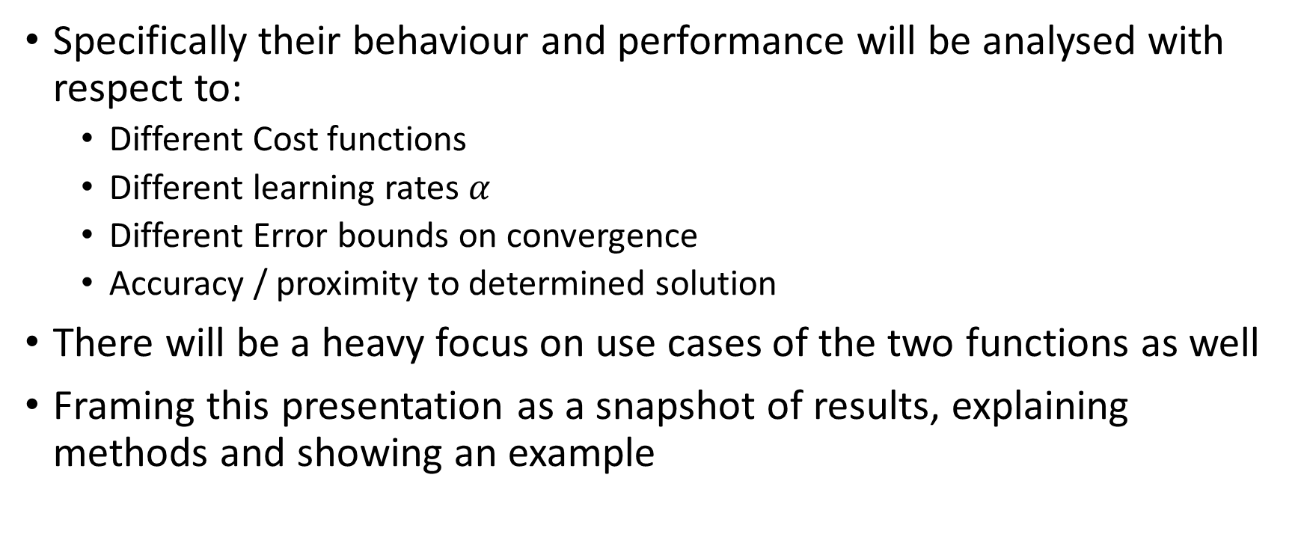
Goal
Specifically their behaviour and performance will be analysed with respect to:
Different Cost functions
Different learning rates $α$
Different Error bounds on convergence
Accuracy / proximity to determined solution
There will be a heavy focus on use cases of the two functions as well
Framing this presentation as a snapshot of results, explaining methods and showing an example

Slide 12
Methods

Slide 13
Focusing the Problem
Chose to make most parameters variable
Fixed size of players (limited for now to 2-player games)
Convex functions
To help with convergence and coding
Problems that are solvable
‘Easily verifiable’

Slide 14
Implementation
Simulations using Python
Focused on making the base function pliable and adaptable
Programming was done for repeatability and ease of applying new functionality
Tried to avoid numerical calculations to cause rounding
Took advantage of symbolic equations (ie when calculating the gradient)
Easily able to pass new functions to make testing easier

Slide 15
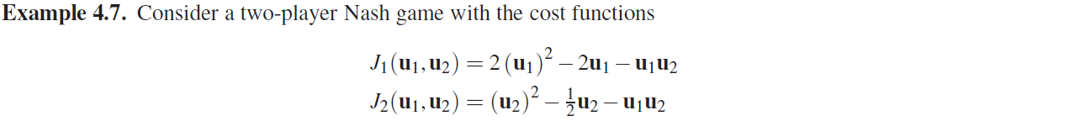
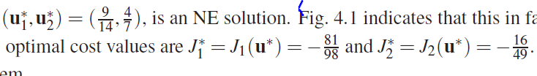
Example Continuous Action Game

Slide 16
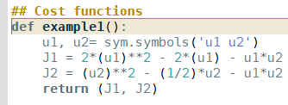
In Code

Slide 17

Demo!
Where applicable, $α=$0.01, error = 0.0000001

Slide 18
Limitations (BR)
Was found to be slower (more iterations) than Gradient play
Convergence typically slower (as per shown examples)

Slide 19
Limitations (Gradient Play)
Issues with gradient play
Concavity requirement
Issues converging based on learning rate

Slide 20
Conclusion
Found gradient play to be a lot more effective,
Tested functions include polynomials up to n^5, nlogn, and other homework problems
However it was less robust
Often hard to tell between functions what the optimal learning rate is
BR can converge fast and accurately and is resilient to a more broad arrangement of learning rates

Slide 21
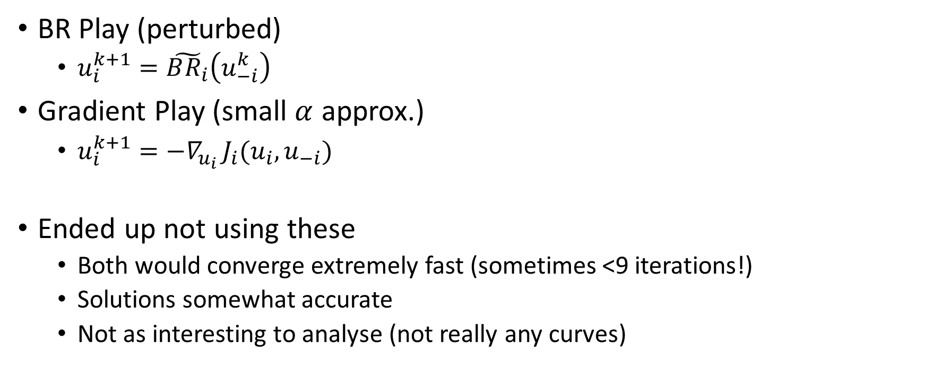
Other approximations
BR Play (perturbed)
$u_{i}^{k+1}=\tilde{BR_{i}}\left(u_{−i}^{k}\right)$
Gradient Play (small $α$ approx.)
$u_{i}^{k+1}=−∇_{u_{i} }J_{i}(u_{i},u_{−i})$
Ended up not using these
Both would converge extremely fast (sometimes <9 iterations!)
Solutions somewhat accurate
Not as interesting to analyse (not really any curves)

Slide 22
Next steps
Continue compiling additional functions
A bit hard to show several different games here
Hope to compile relative accuracies / statistical difference between BR and GP
Continue working on tools
GUI
Adaptive / better gradient play
Work on N>2 (ie 3 players)

Slide 23
Thank-you!

Slide 24
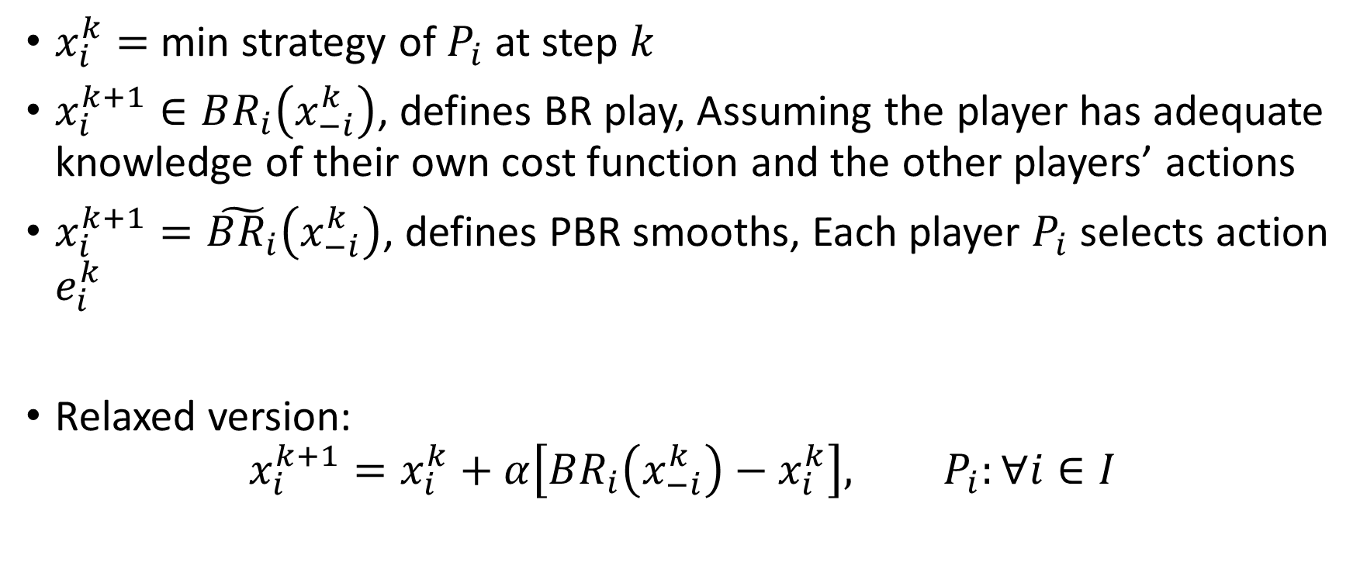
Repeated Game Setup (non-Continous notes)
$x_{i}^{k}=$ min strategy of $P_{i}$ at step $k$
$x_{i}^{k+1}∈BR_{i}\left(x_{−i}^{k}\right)$, defines BR play, Assuming the player has adequate knowledge of their own cost function and the other players’ actions
$x_{i}^{k+1}=\tilde{BR_{i}}\left(x_{−i}^{k}\right)$, defines PBR smooths, Each player $P_{i}$ selects action $e_{i}^{k}$
Relaxed version:
$$x_{i}^{k+1}=x_{i}^{k}+α\left[BR_{i}\left(x_{−i}^{k}\right)−x_{i}^{k}\right], P_{i}:∀i∈I$$

Slide 25
Variables

Slide 26
BR Play Pseudocode

Slide 27
Gradient Play Pseudocode

Slide 28
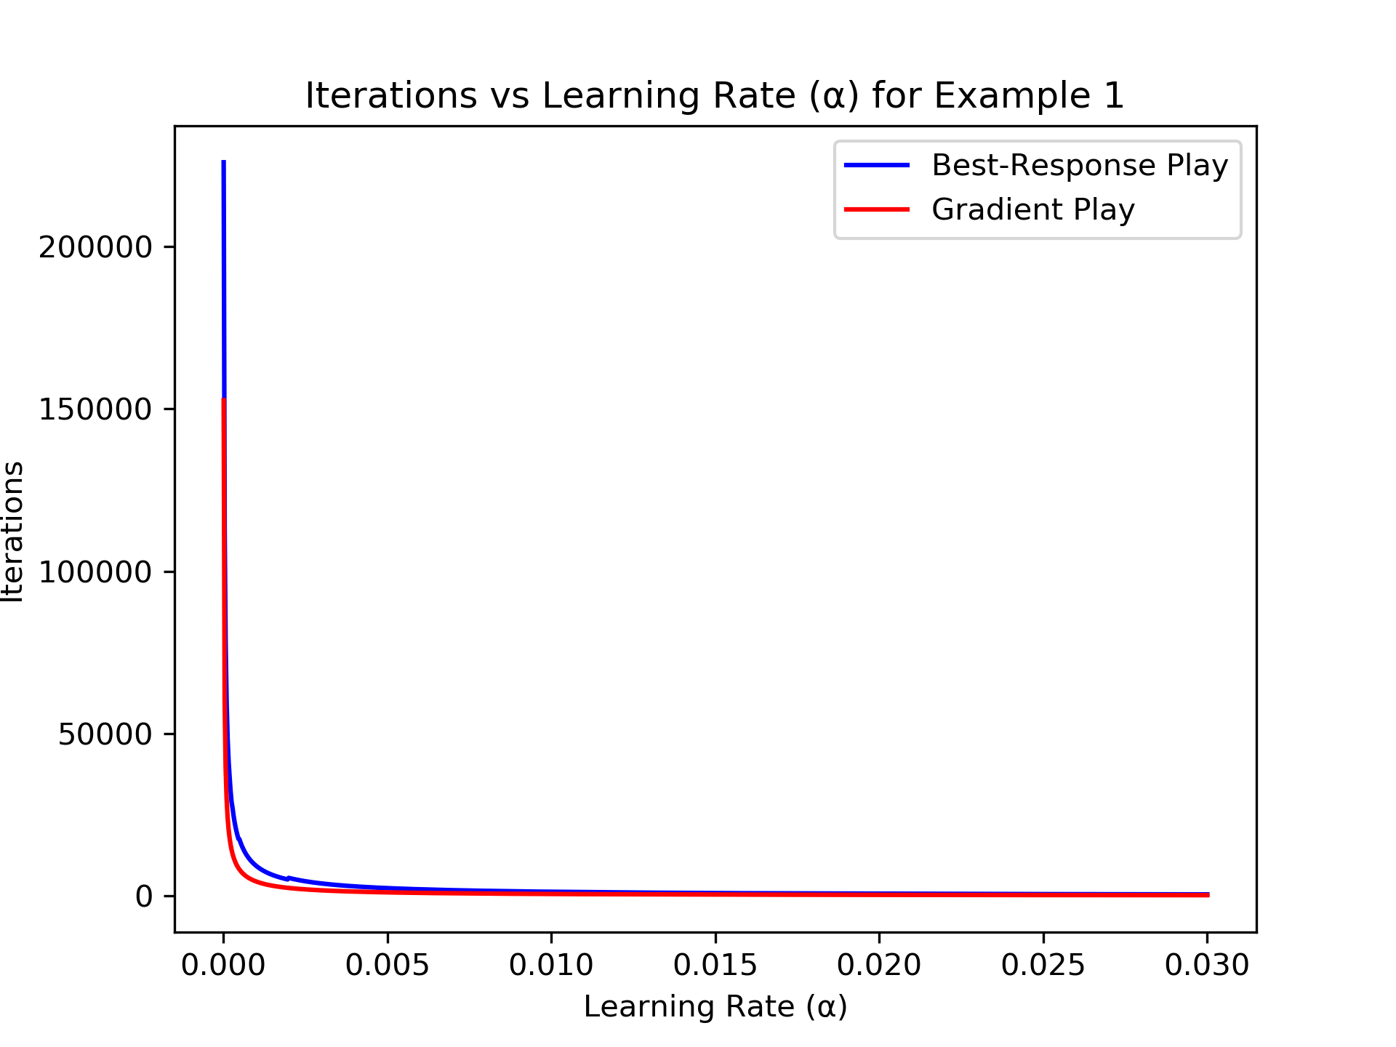
Iterations vs Learning Rate
Gradient

Slide 29
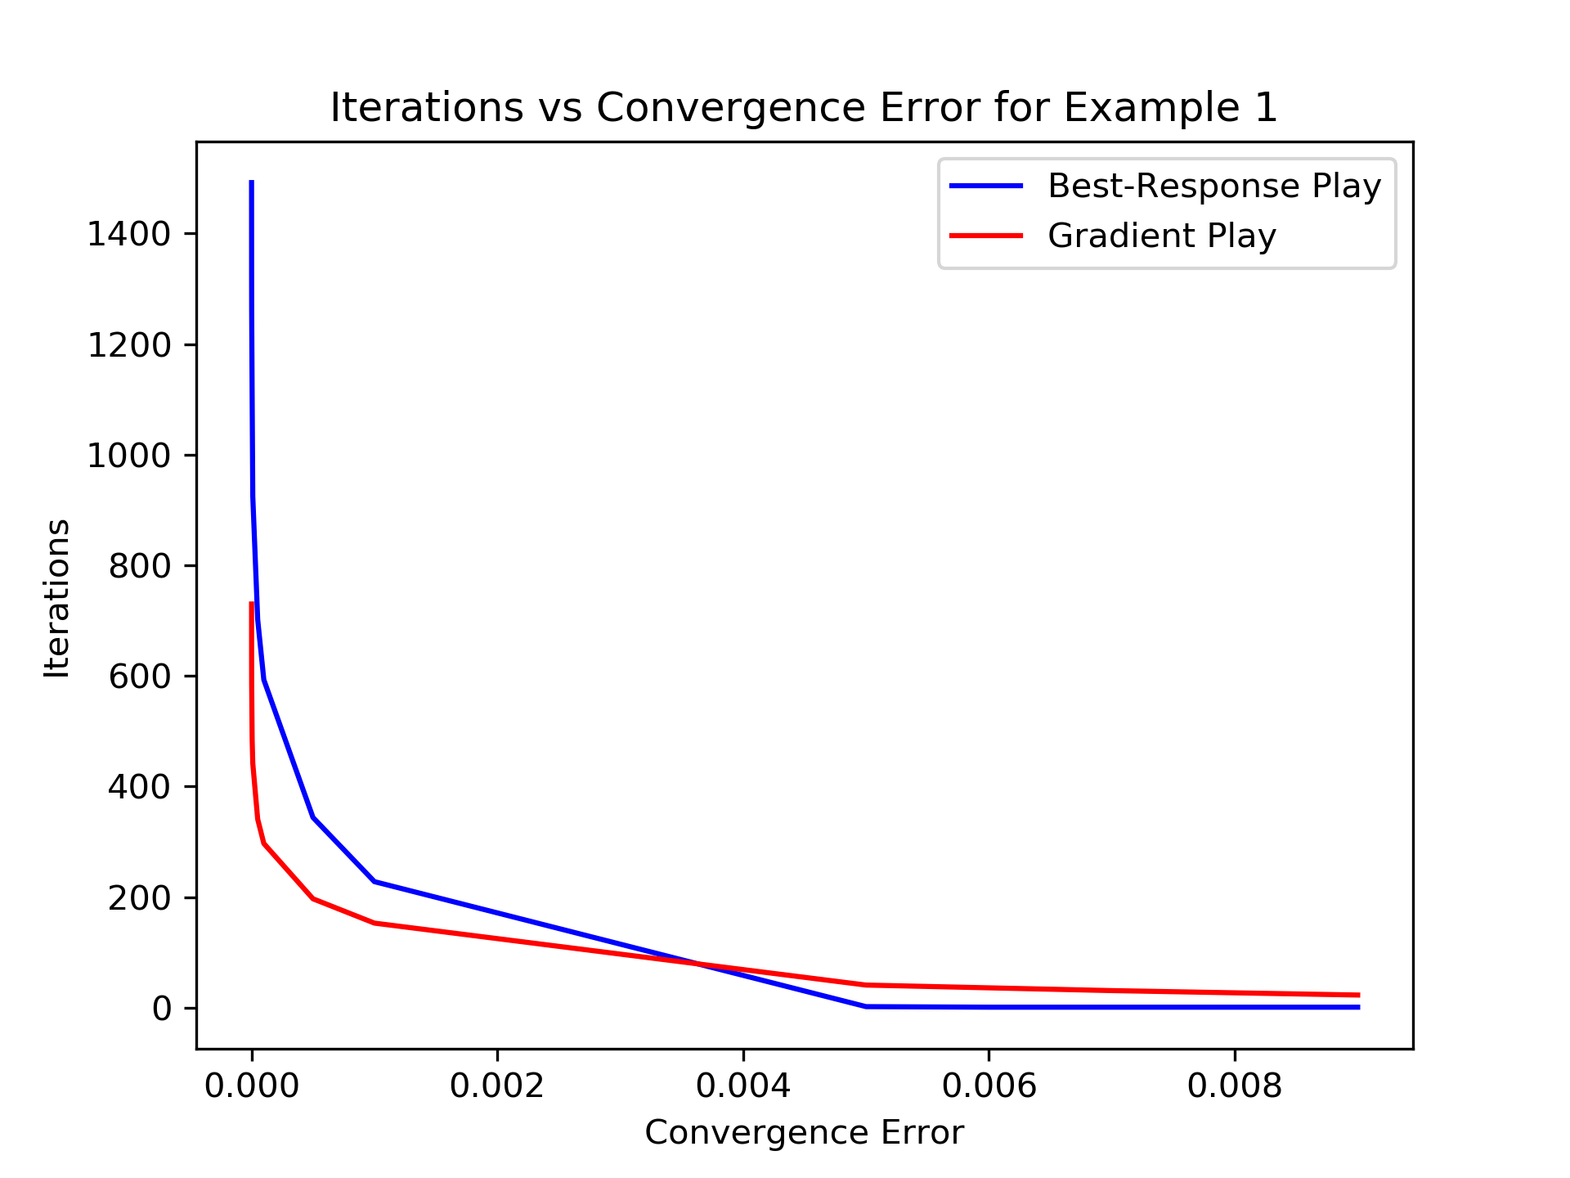
Iterations vs Convergence Error

Slide 30
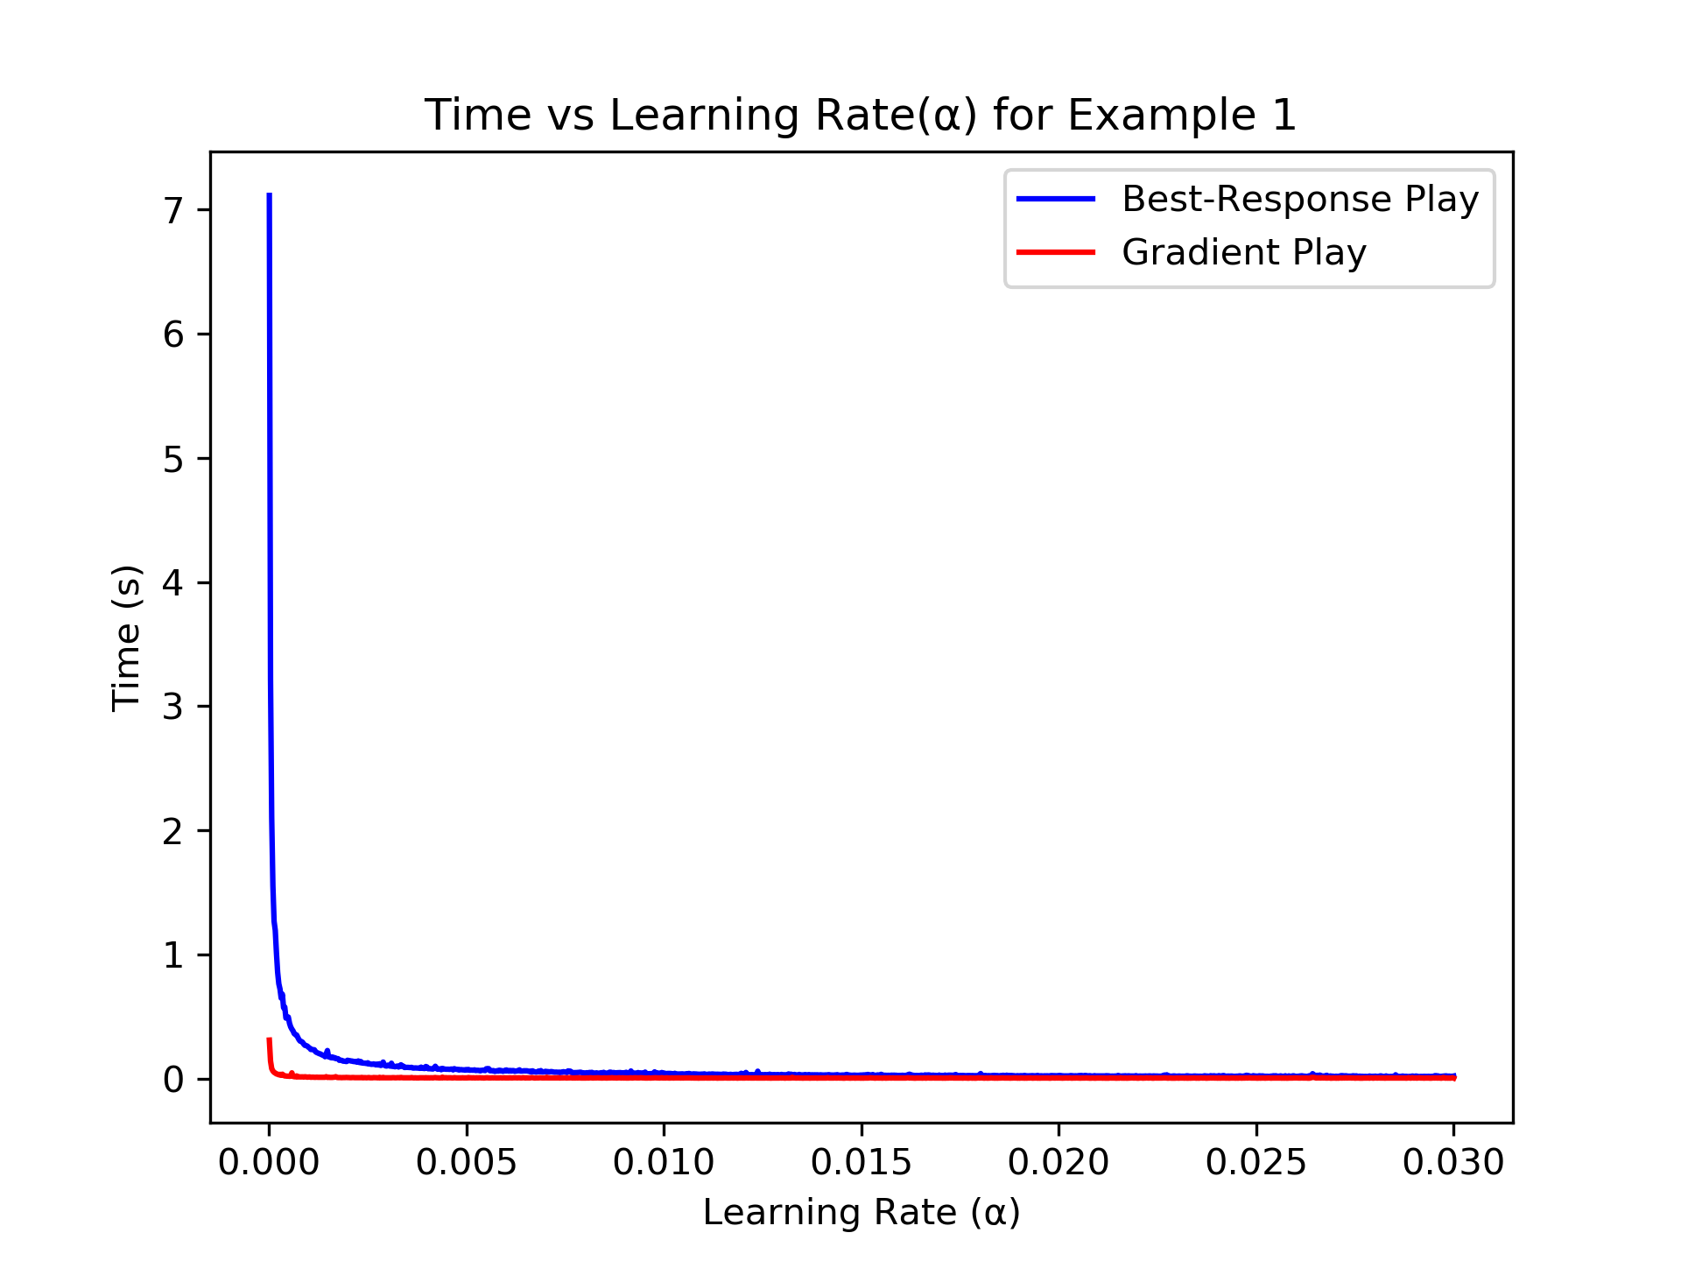
Time vs Learning Rate

Slide 31
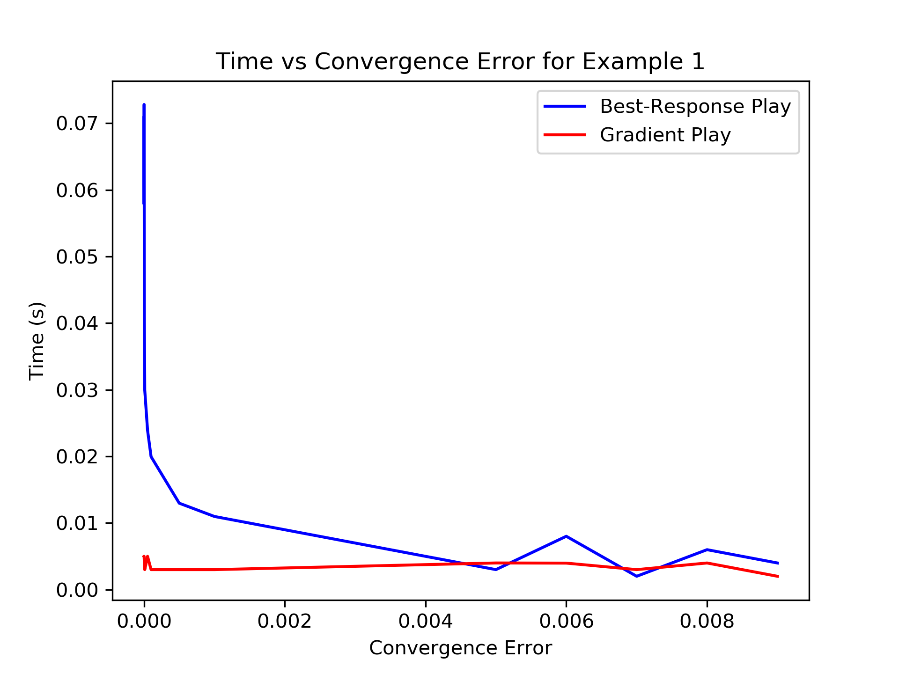
Time vs Convergence Error

Slide 32
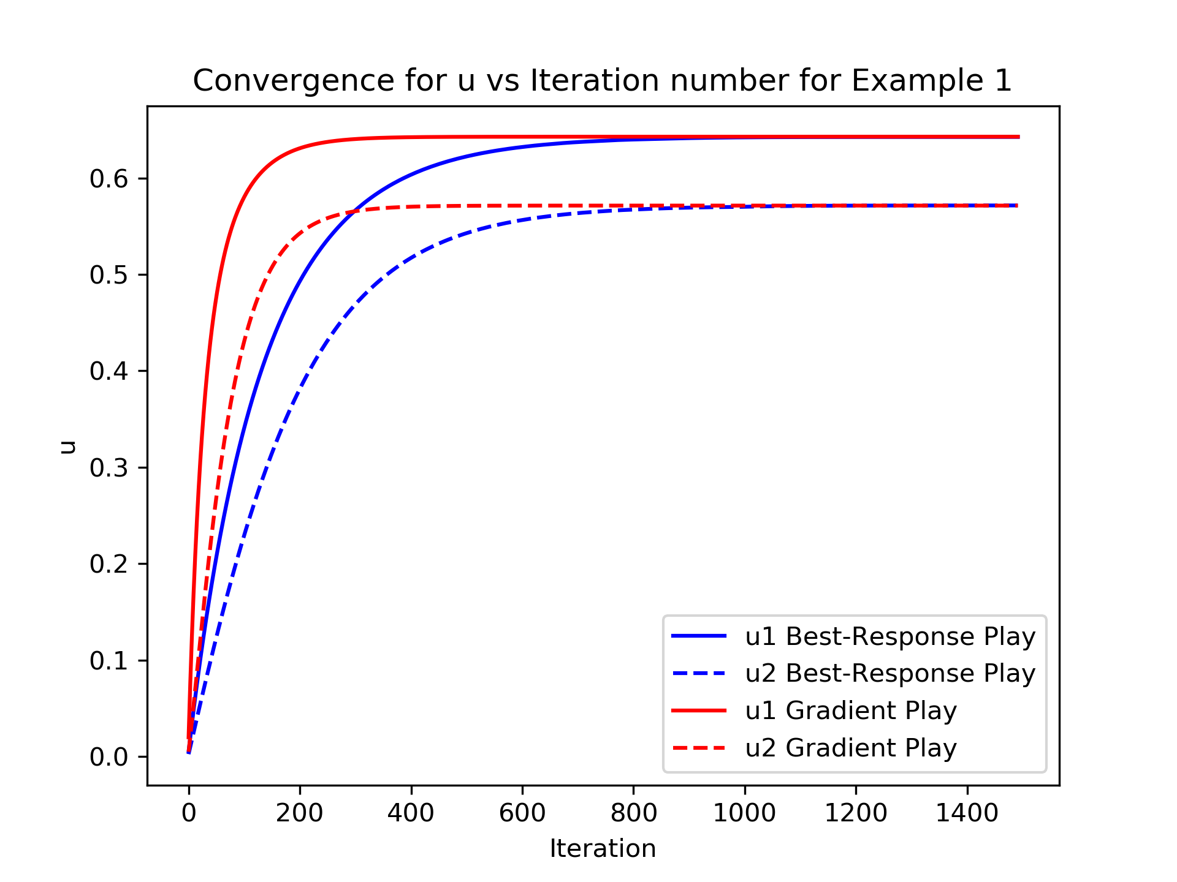
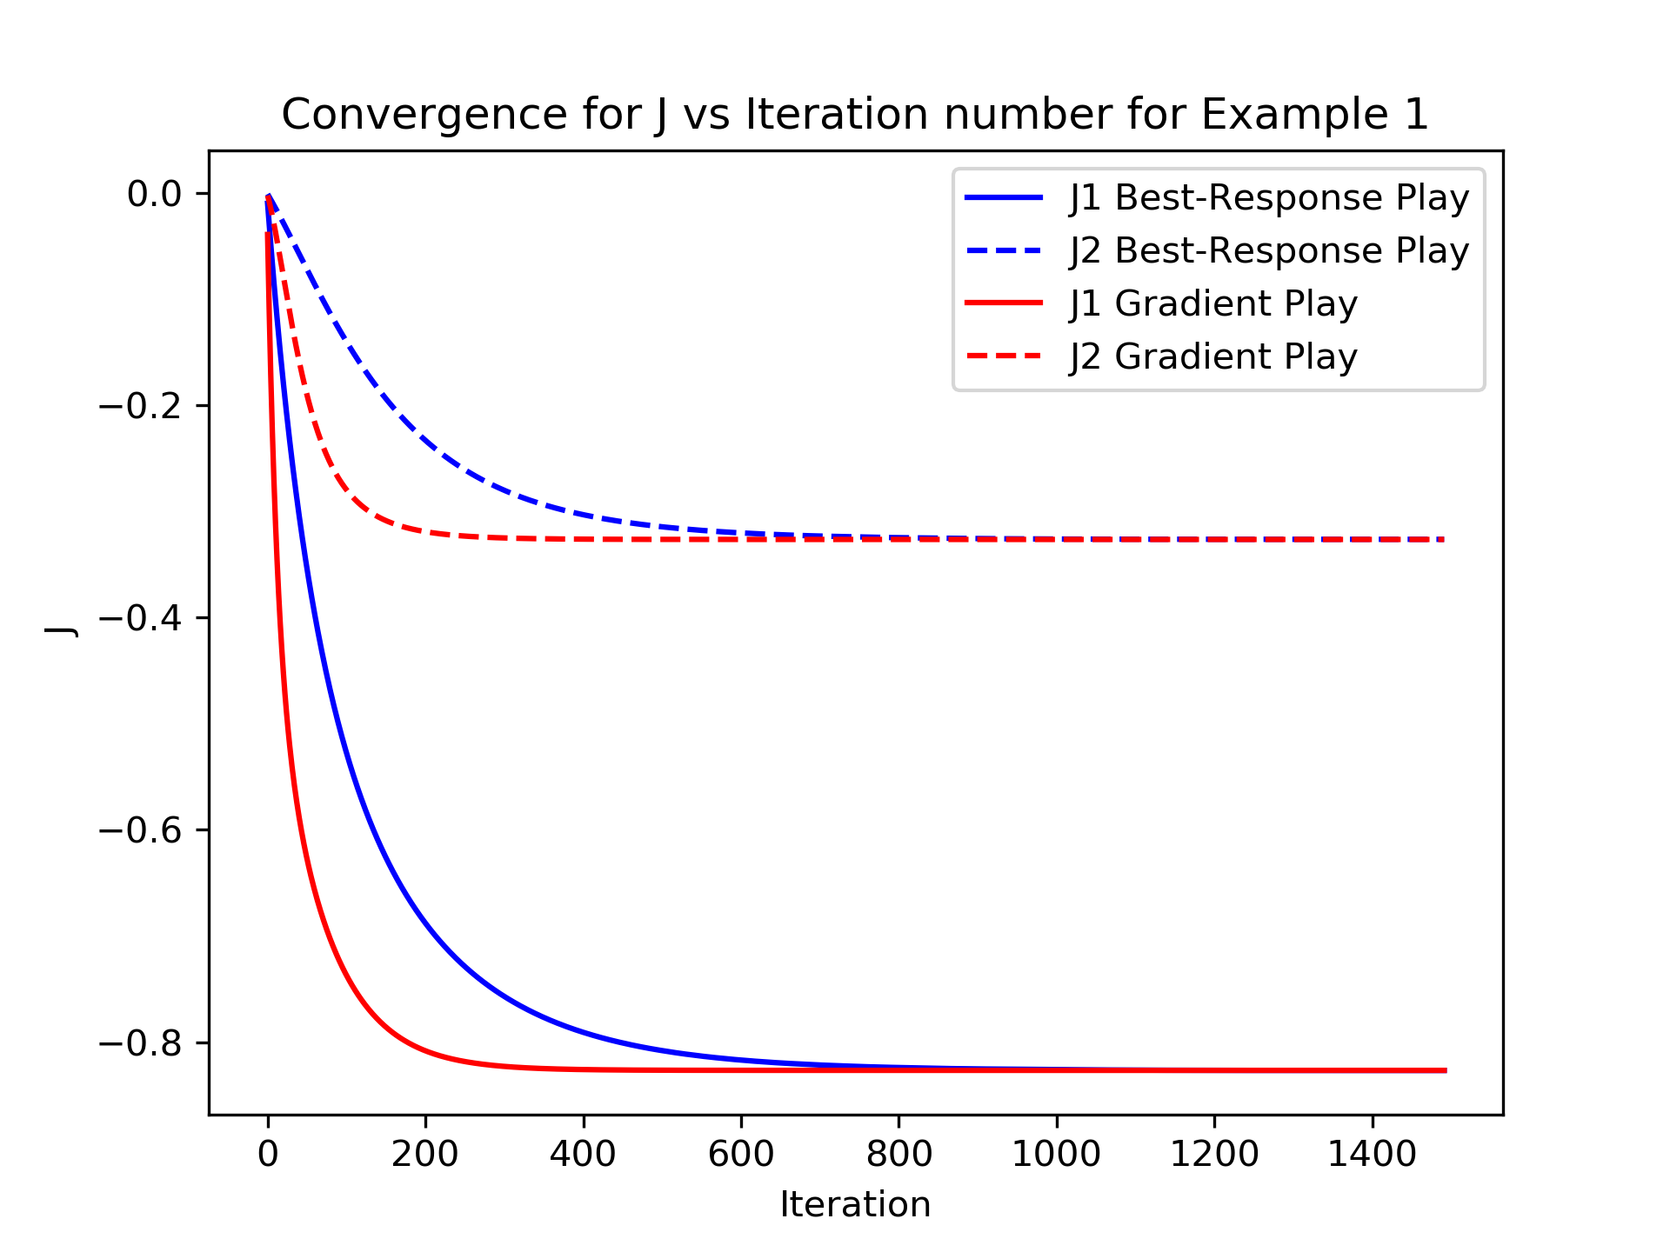
Convergence on Solutions

